Slide 1
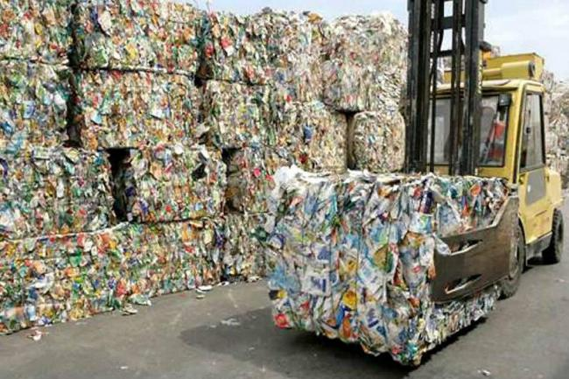
Recycled Paper Mache 3D-Artitic Reflection
THEME: Human Consumption’s Footprints MATERIAL: Recycled Paper EXPECTATION: To Make a Positive Impact with our Function as an Artist

Slide 2
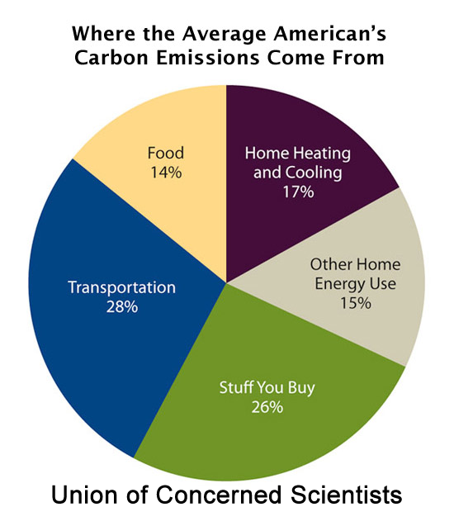
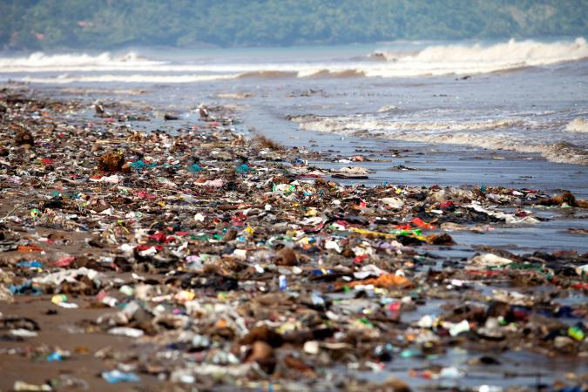
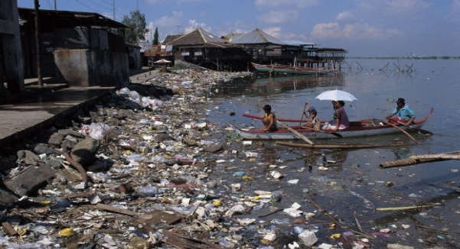
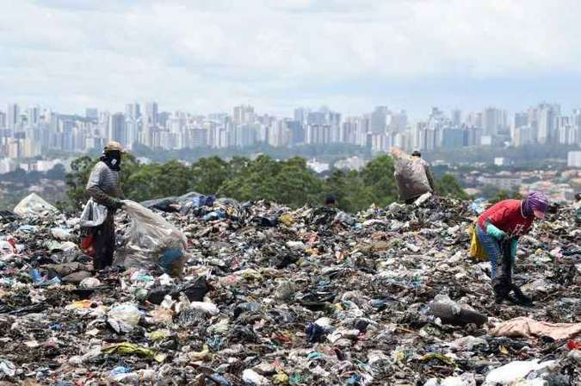
Footprint Reflection *How do you contribute to these impacts? * What are some of the aspects that you are most concerned about it? * How can you visually express your reflection?

Slide 3
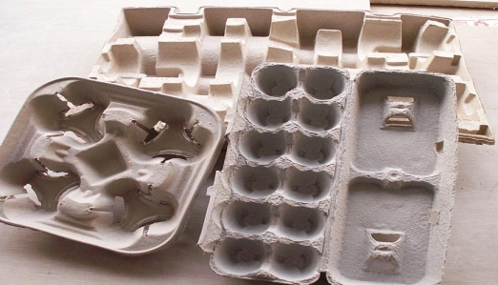
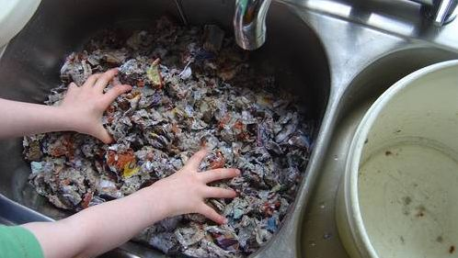
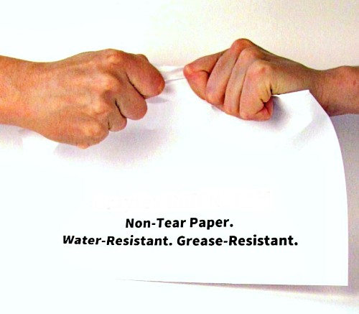
Material
COLLECT ANY PAPER THAT
CAN BE RECYCLE
THE SOFTER = THE BETTER
SYNTETIC PAPERS ARE NOT ALLOWED

Slide 4
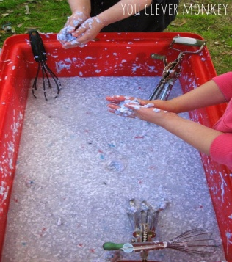
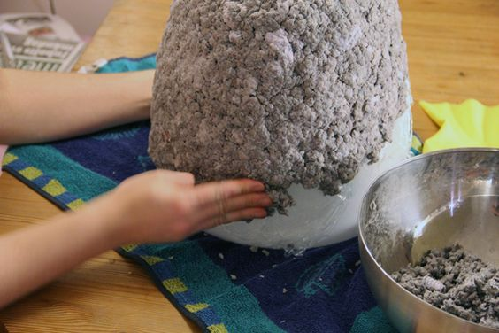
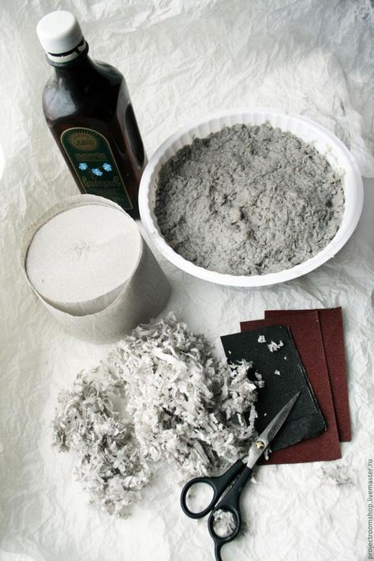
Secondary Materials & Processes Preview

Slide 5
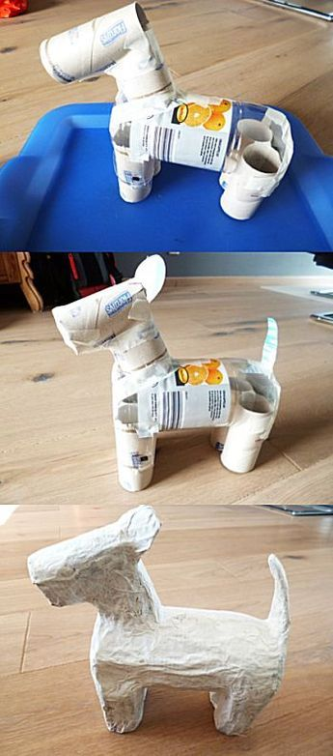
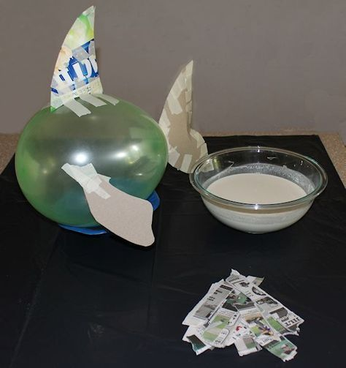
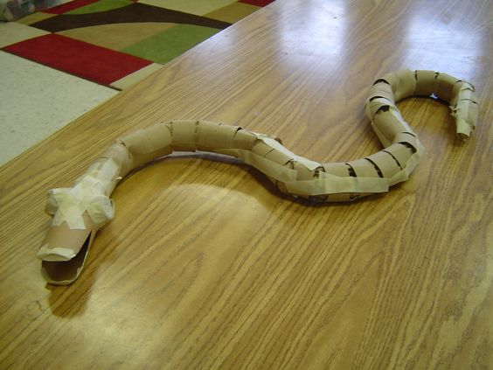
Three-Dimensional: Having height, width, and depth. Also referred to as 3-D
DESING CONSIDERATIONS
Assemblage
Form
Shape
Space
Structure

Slide 6
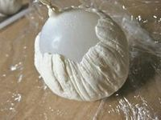
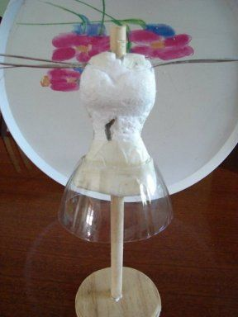
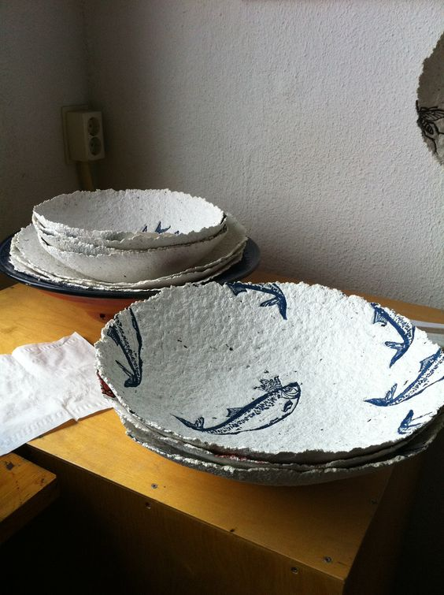
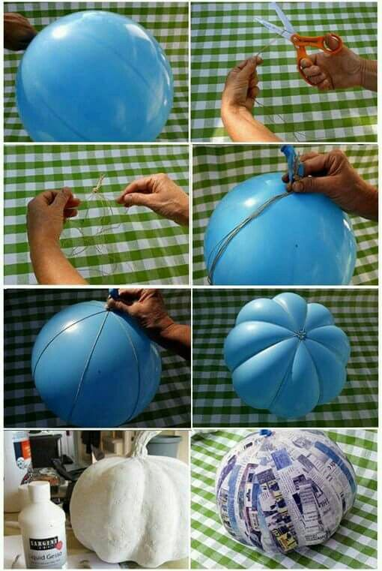
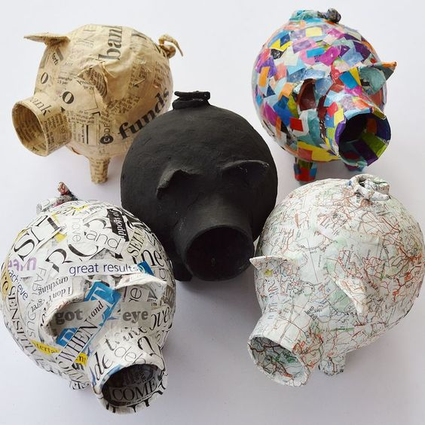
Ideas & Exceptions
FASHION INDUSTRY
FOOD JUSTICES
ANIMAL
CRUELTY

Slide 7
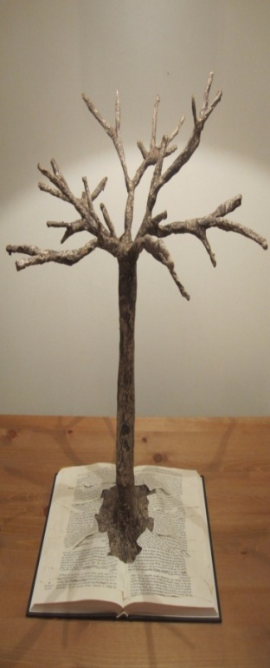
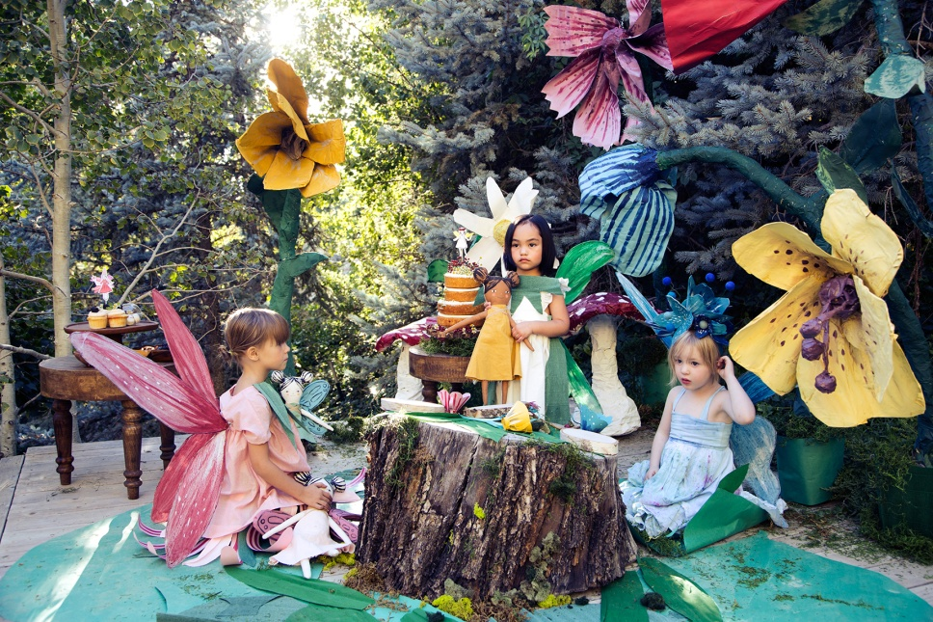
Composition: the organization of elements in a work of art
CONSIDER:
Aesthetics Balance
Design Harmony
Proportion Scale
Texture Volume
FAUNA AND FLORA
FAUNA AND FLORA
MANAGEBLE DESING
TIME & SKILLS
FAUNA AND FLORA

Slide 8
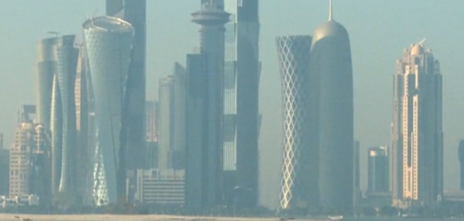
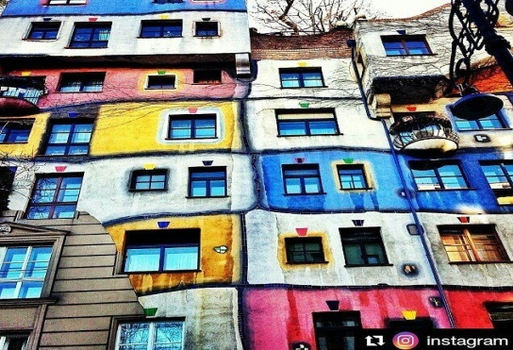
Color: The visual sensation dependent on the reflection or absorption of light from a given surface. .
Arbitrary colors Color Relationships Complementary Colors Monochromatic Tone Value

Slide 9
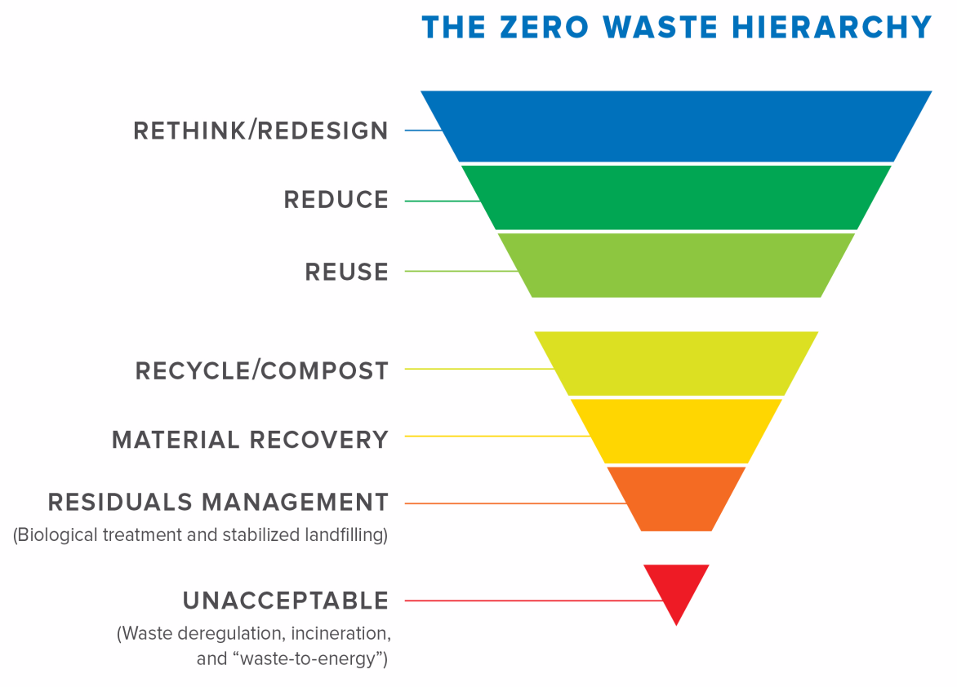
Reflection and Discussion
Towards completion, class will present their piece for reflections and discussions

Slide 10
Rubric
Criteria | Superior | Adequate | Below
Design and Concept | The student has followed procedure and produced a compelling piece that not only use materials properly but also deliver a cohesive response to the issue introduced in the assignment. | The student has somewhat followed procedure and produced an accepted piece that not only use materials properly in some cases, but also deliver a accepted response to the issue introduced in the assignment. | The student has not followed procedure, did not only use materials properly, or deliver a accepted response to the issue introduced in the assignment.
Craft | Student managed skills well and strived to gain new abilities. | Student used basic skills. | Students did not use skills properly.
Time Management | Student pays close attention to time management and reached all due dates. | Student was somewhat attentive to time management and failed to reach one or two due dates. | Student did not pay attention to time management and failed behind during lesson’s periods.
Attention | The student stayed on task and engaged during entire process. | The student stayed on task and engaged most of the time during process. | The student was off task for a good portion of the time and struggled to be engaged during process.
Reflection | Along with an image of final work, the student submitted a cohesive reflection that included four or more vocabulary words. | An image of final work was not submitted or/and the student submitted a reflection that was not cohesive or included vocabulary words. | The student did not write a reflection.
Critique and Discussion | The student presented final work cohesively and respectfully engaged with class critique and discussions. | The student presented final work somewhat cohesively and was not respectful or engaged with class critique and discussions. | The student did not presented final work cohesively and was not engaged with class critique and discussions.
Please refer to syllabus for due dates and further details
OFFICE HOURS: 00:00 M – W
EMAIL: MMM@CSULB.COM

